Slide 1




CHATBOT FOR MEDICOS
PROJECT OVERVIEW

Slide 2
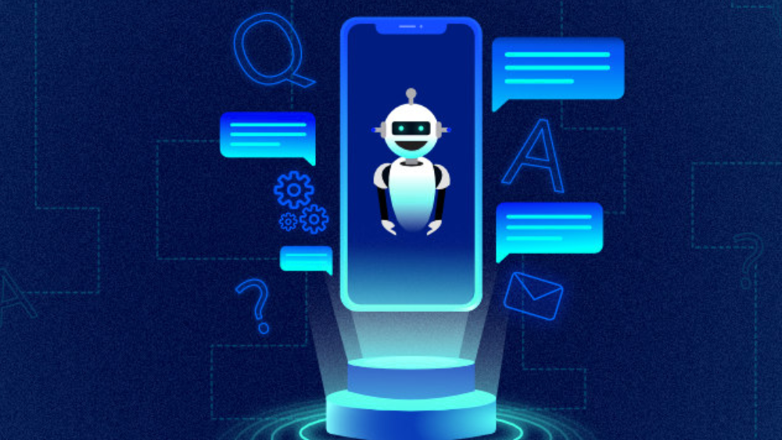

INTRODUCTION
Chatbots, empowered by artificial intelligence, are becoming increasingly popular in many fields and have much potential for application in real life situations.
However, little attention has been paid to medical chatbots and most existing evidence focuses on technical issues while behavioral research is still lacking.
The idea is to create a medical chatbot that can diagnose the disease and provide basic details about the disease before consulting a doctor.
This will help to reduce healthcare costs and improve accessibility to medical knowledge through medical chatbot.

Slide 3
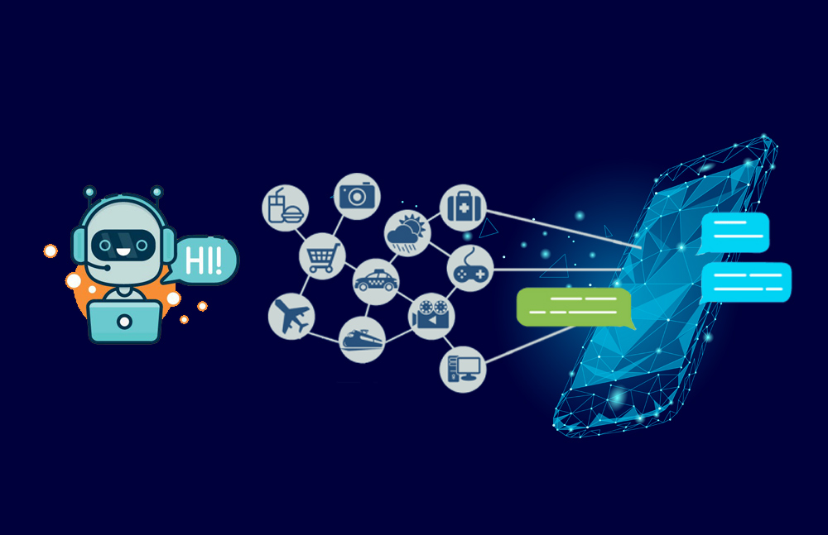


PROBLEM STATEMENT
One in every twenty Google searches is about health, this clearly demonstrates the need to receive proper healthcare advice digitally.
A number of internet users depend on the internet for clearing their healthcare-based queries.
Chatbots use natural language processing and machine learning to understand and respond to patient queries, providing medical advice, diagnoses, and treatment recommendations.
Seeking medical guidance in an easier way and getting exposure to various diseases and diagnosis available for it is the major scope of the problem.

Slide 4
OBJECTIVES AND GOALS
GOAL #1
QUICK AND EASY ACCESS TO HEALTH CARE INFORMATION AND SERVICES
GOAL #2
ANSWERING COMMON HEALTH QUESTIONS,
GOAL #3
SUGGEST SUITABLE TREATMENT OPTIONS
The goal of a healthcare chatbot is to be able to improve patient engagement and satisfaction by providing personalized, 24/7 support and information on their health concerns.

Slide 5
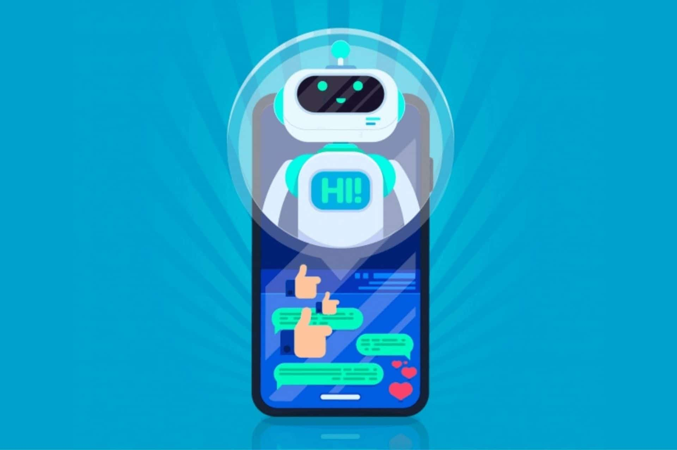
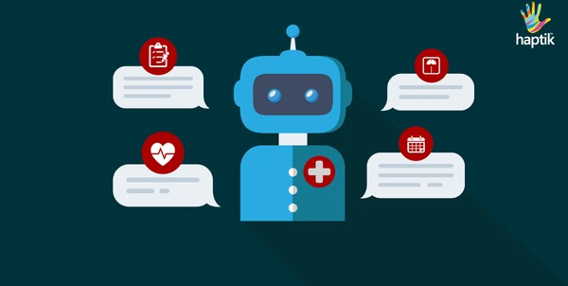







KEY FEATURES
REDUCED COSTS
Chatbot is an advantage for companies receiving multiple queries at a timeas it eliminates the requirement of any manpower during online communication.
24-7 AVAILABILITY
Chatbot once installed can answer queries at any time. Companies canreach out to them later as they trace their activities during non- working hours.
UPDATING AND LEARNING
Chatbot have the ability of updating and learning themselves on
their own from the transactions. Due to algorithms and machine learning, they are capable ofupdating themselves.
MULTIPLE CUSTOMER HANDLING
Humans can handle a limited clients at a time. However,
there is no such restriction with chatbots they can solve as many queries as required at once.

Slide 6

EFFECTIVENSS
In the healthcare industry, every fraction of time weighs significance. People do not want to engage in waiting lines or sit by the phone looking out for a response from medical professionals. In this post-pandemic world, healthcare providers have to be more keen-eyedwith their approach to customer service.
Given the sense of fear and watchfulness the virus has evoked among people, it is vital for the healthcare industry to stay ahead of the game.
This takes them to the implementation of healthcare chatbots. The chatbots have proved to be very effective in the healthcare industry providing with prompt response, reduced cost and time, quick access to critical info, assistance with medications and reminders.

Slide 7
DATA FLOW DESIGN

Slide 8
DRAWBACKS
LACK THE ABILITY TO UNDERSTAND COMPLEX MEDICAL LANGUAGES.
LIMITED IN THEIR ABILITY TO HANDLE EMERGENCY SITUATIONS OR UNDERSTAND THE UNIQUE NEEDS OF EACH PATIENT.
CONCERNS AROUND PRIVACY AND SECURITY OF PATIENT DATA WHEN USING CHATBOTS FOR HEALTHCARE CONSULTATIONS.
THE POTENTIAL FOR ERROR OR MISINTERPRETATION OF INFORMATION PROVIDED BY USERS. THERE ARE CONCERNS OVER THE ACCURACY OF DIAGNOSES
RECOMMENDATIONS, AND TREATMENTS SUGGESTED BY CHATBOTS

Slide 9

CONCLUSION
In conclusion, healthcare chatbots have the potential to revolutionize the healthcare industry by providing patients with access to reliable and convenient healthcare services.
Healthcare chatbots can provide patients with personalized care, automate routine tasks, reduce wait times, and improve patient outcomes.
To ensure that the healthcare chatbot meets the user's needs, it is essential to involve healthcare professionals, patients, and other stakeholders in the development process.

Slide 10

DIVYANSH ABHAY ARYA VANSH LOKESH PRANAV
21BCS3987 21BCS3990 21BCS3956 21BCS3911 21BCS3735

